Slide 1
M.S.RAJU ARTS
LOVECHESE
M.S.RAJU
K.KODANDARAMIREDDY
MANISARMA
102 RELESE
50 days 13CENT’S
75 – 2 CENTS
100-1CENTER

Slide 2

152 RELESE
50 days 63CENT’S
75 – 25 CENTS
100-11CENTER
125- 3 cents
150-1cent 156

Slide 3
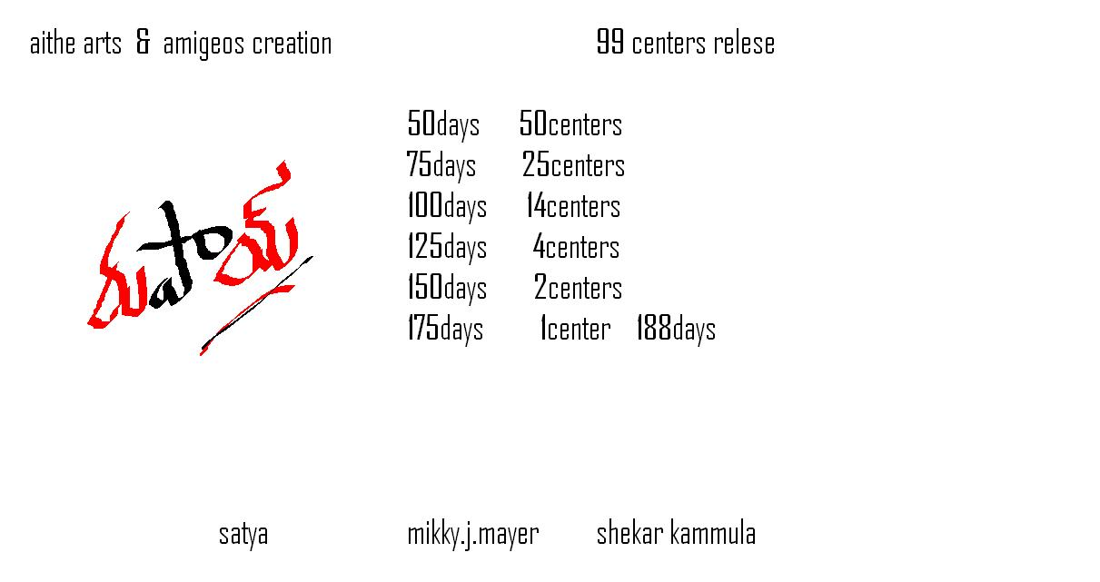
188days

Slide 4
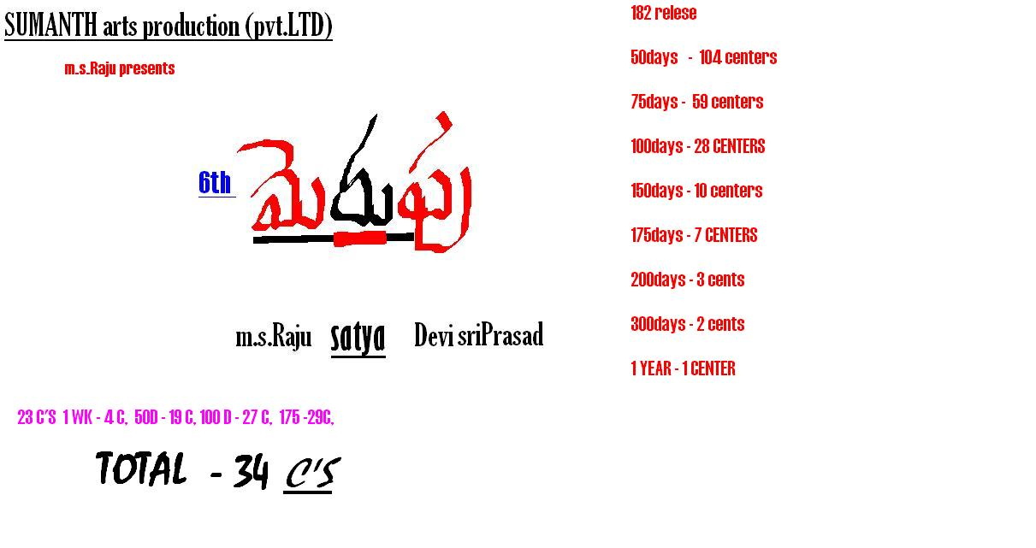
400days
Swarna DTS a/c

Slide 5
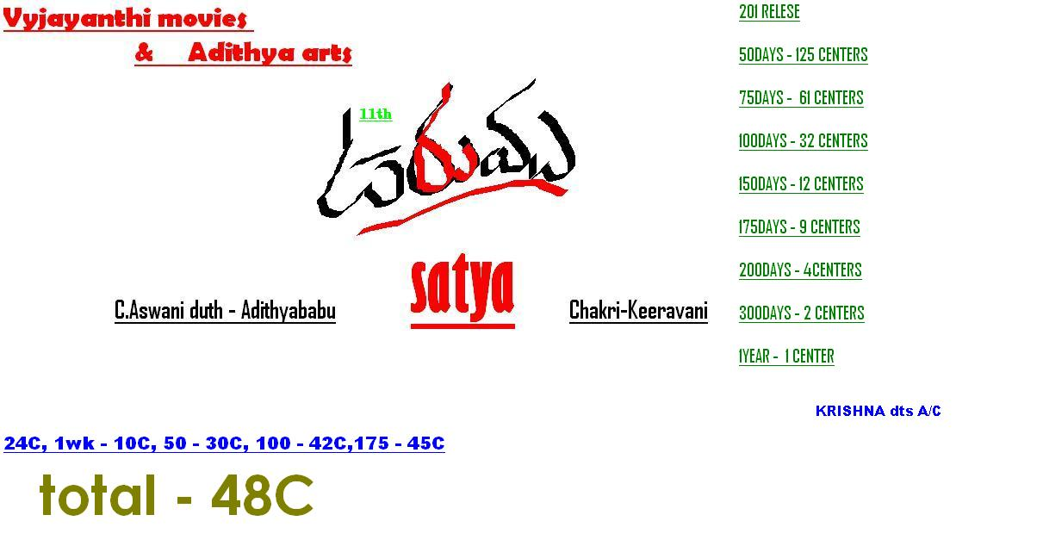
409days

Slide 6
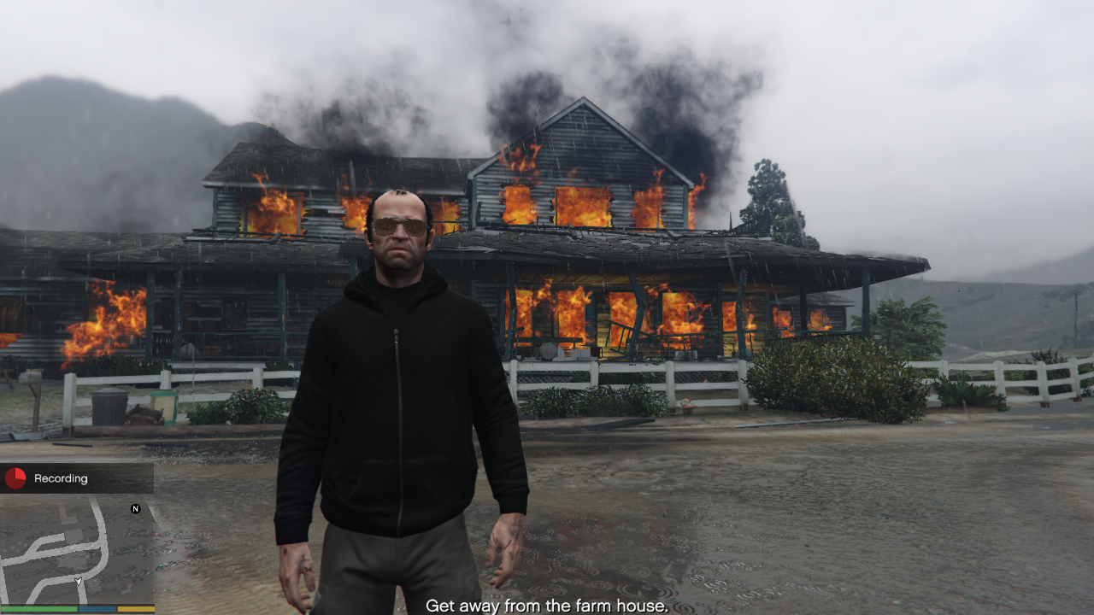
HEIST
Satya
Pawan.CH – Ravi Basur

Slide 7
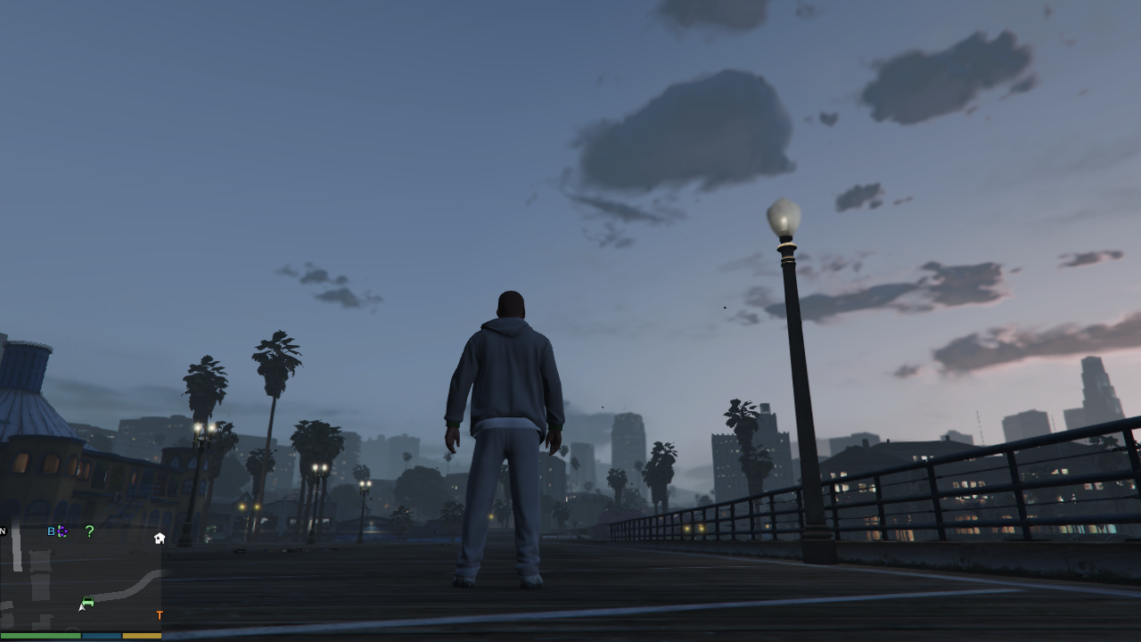

స్నేహం
Trivikram
S.ChinaBabu
Anirudh

Slide 8
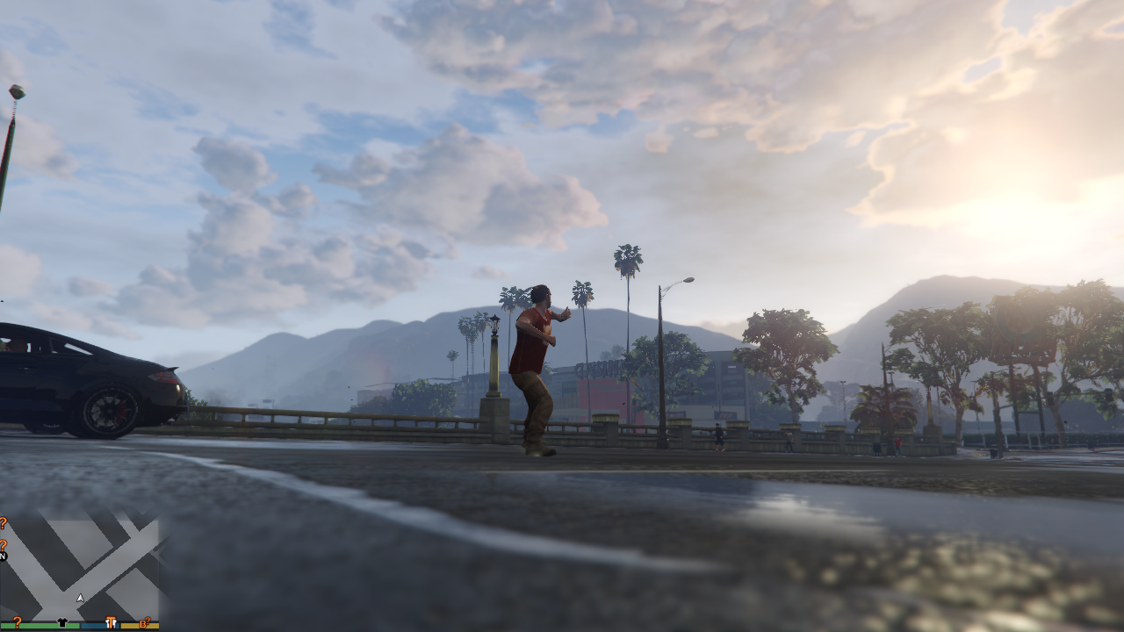

ధాయాది
SUDHER VARMA
Nagarjuna Akkineni SandeepChowtha
Story – Screenplay
Ramgopal Varma – Chandrashekar Yeleti

Slide 9
దొంగలాట

Slide 10
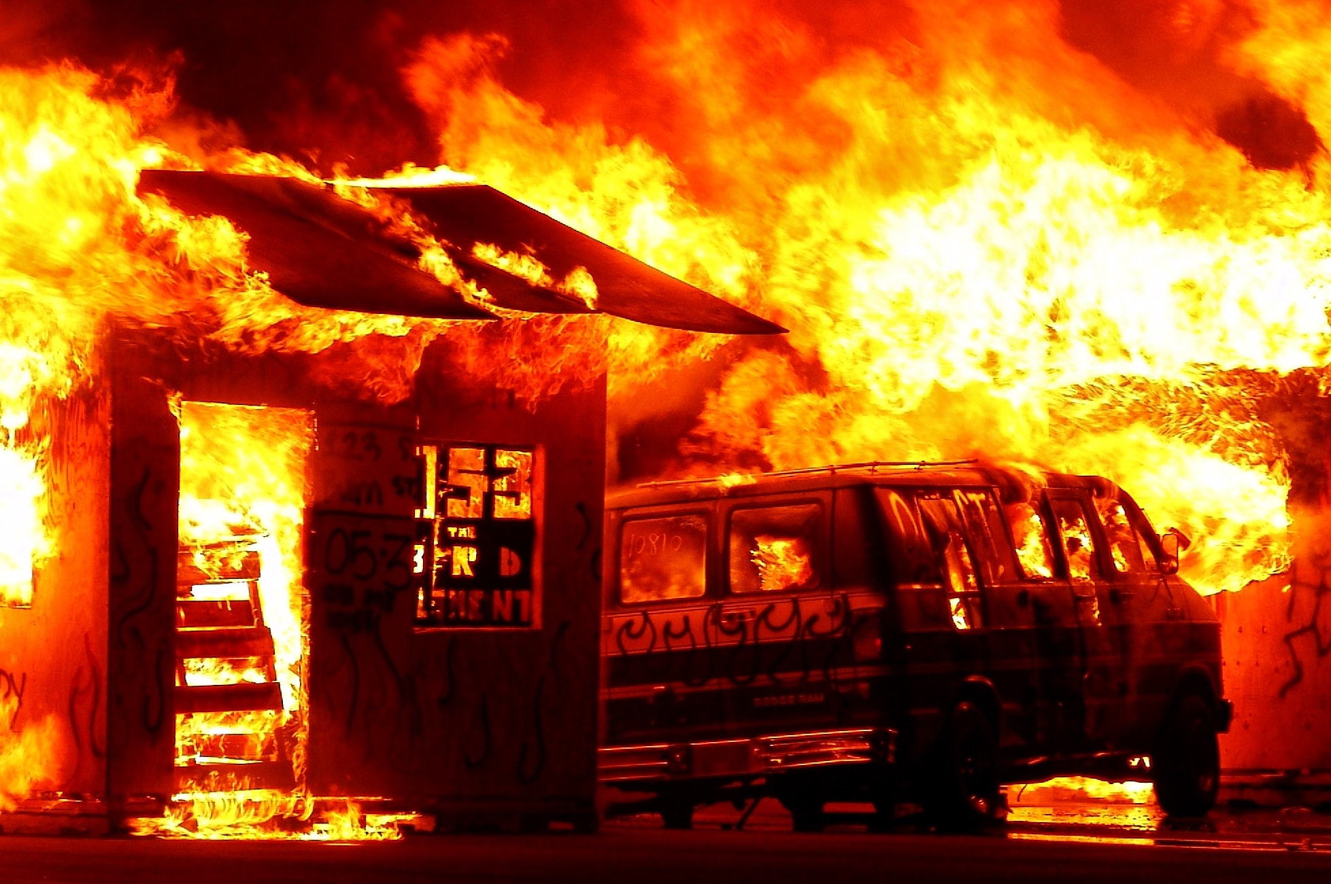
ఎస్.ఎస్.రాజమౌళి
అగ్నిస్థలీ

Slide 11
ఏజెంట్స్
ఏజెంట్స్
________
Puri Jagganath
Yavan Shankar Raja

